Slide 1
HUMANITIES SYNTHESIS PROJECT
ART BY AFRICAN AMERICANS

Slide 2
Introduction
The presentation is on some of the significant art work by famous black artists in America.
I chose to present African American artworks because their work depict the history of the black people in America.
The paintings, sculpture, and photographs explore themes that reflect the African American experience.
Many reflect the tremendous social and political change that has occurred over the years in American history.
Notes:
America is rich in history and African Americans are part of this history. African Americans have had quite a history in the country. And famous black artists have played an important role in displaying the experience of black people in American society. From an important grouping of recently acquired works by self-taught artist Bill Traylor to William H. Johnson’s vibrant portrayals of faith and family, to Mickalene Thomas’s contemporary exploration of black female identity, the artists portray important themes in the life of the black people. Many of their artworks reflect the tremendous social and political change that occurred from the early Republic to the Civil War, through the rise of industry, the Jazz Age and the Harlem Renaissance, the post-war years, the Civil Rights movement to present day questions of self and society.

Slide 3
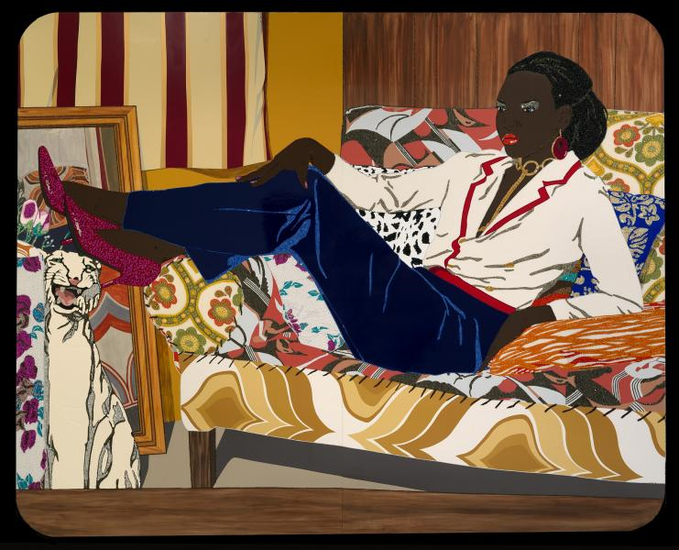
Portrait of Mnonja
Notes:
This is a 2010 artowrk by one of the famous artists called Mickalene Thomas. She is one of the contemporary artists who explores themes of black female identity. Mickalene Thomas creates large-scale paintings of African American women to explore notions of sexuality and race through rituals associated with female beauty. Her models dress up and pose for photographs on a studio set; she works from these photographs to produce finished works. Rhinestones and sequins recall folk art traditions as well as the jewelry and cosmetics that can enhance or mask a woman’s identity. Mnonja depicts dignity and self-assurance as she reclines against a wood-paneled background which depicts a seventies-ear family room.

Slide 4
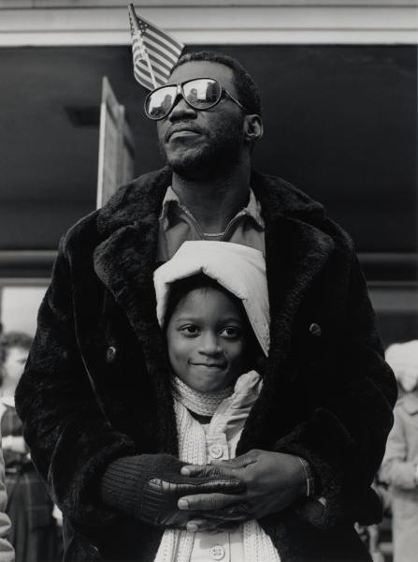
The Guardian
Notes:
“The Guardian” is a 1990 famous piece of artwork by Earlie Hudnall, Jr. Many of Hudnall’s pieces of work focus on children and elderly. In this piece of work, a father enfolds his young daughter as they stand along a street reflected in the mirrored lenses of his glasses. The American flag tucked behind his ear perhaps suggests more-that in addition to warmth and affection, he is passing on a sense of community and patriotic pride. The 1990s was an era where African Americans faced many challenges as they were starting to discover their identity in the white-dominated American society. But despite these challenges, Hudnall shows patriotism to America and is happy to be part of this great nation.

Slide 5
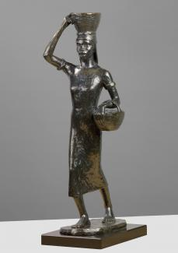
Blackberry Woman
Notes:
This is a famous piece of art by Richmond Barthe. The subject of the arrtwork-an African American woman in a simple dress who is balancing a basket on her head- depicts a traditional African woman. Blackberry Woman is more than an echo of an image once observed. She has the frontal, linear form found in West African sculpture, which Barthe once said he saw in Chicago, in an exhibition during “The Negro in Art Week” in November 1927, when he was still studying at the School of the Art Institute of Chicago. He took the title Blackkberry Woman from Wallace Thurman’s 1929 book, “The Blacker the Berry: A Novel of Negro Life, a story of discrimination against black women with the African American society. The woman’s bare feet, simple cotton dress, and attached baskets evoke the extreme poverty of Barthe’s youth in rural Mississippi where he often saw black women carrying bundles on the heads.

Slide 6
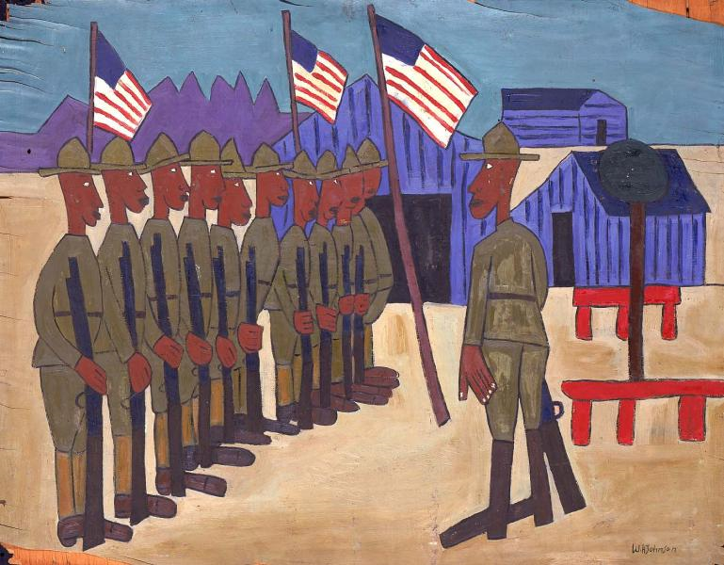
Soldiers Training
Notes:
This is famous 1942 piece of art by William H. Johnson. Johnson painted scenes of African Americans involved in the war effort. “Soldiers Training” contrasts the patriotism of black enlistees with the military's segregationist policies. Black soldiers trained in the own units, black blood was kept separate from white and recruits took on the most menial jobs at Army bases and aboard ships. Johnson may have painted this scene based on reports of the “Buffalo Soldiers” who were training at Fort Huachuca, Arizona. This piece of art suggests the isolation that black soldiers experienced among hundreds of thousands of men and women committed to winning the war.

Slide 7
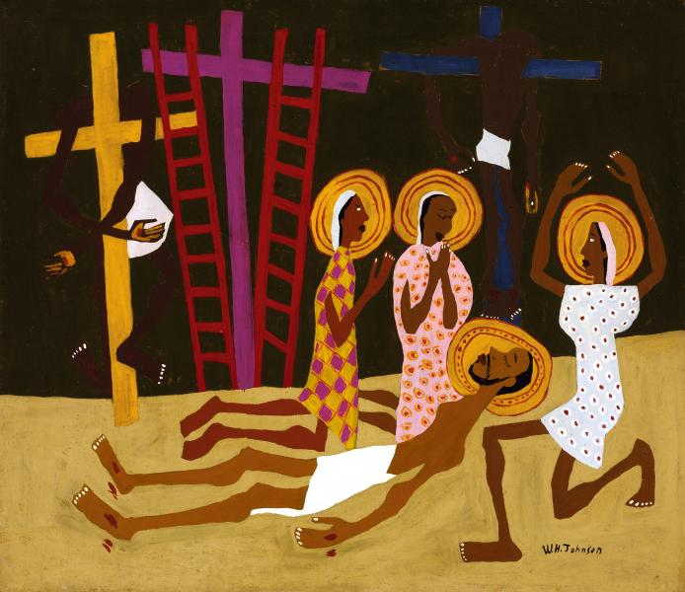
Lamentation
Notes:
This is a 1944 piece of art by William H. Johnson. Johnson began painting religious scenes in the 1940s, after the death of his wife, Hocha. In this piece of art, the light-skinned Christ with a neatly trimmed beard may symbolize the artist, still wounded from the loss of his partner. Three women in brightly printed cotton shifts raise their hands in stylized gestures that evoke African mourning rites, and the ladders, which appear in European scenes of the Crucifixion, also bring to mind African American spirituals like “Jacob’s Ladders.” In Lamentation, Johnson filtered his personal grief through centuries of European art, African traditions, and the public expression of faith in African American churches.

Slide 8
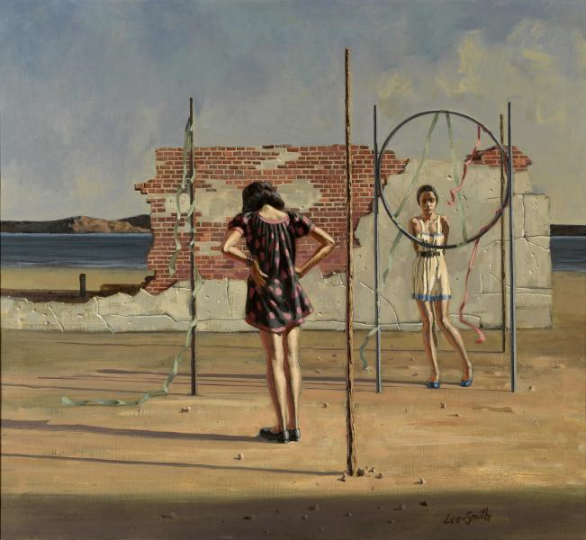
Confrontation
Notes:
This is a 1970 piece of art by Hughie Lee-Smith. In this work, Lee-Smith conveys the alienation and isolation experienced by many African Americans during the middle decades of the 20th century. It depicts the inability of to reach out and connect with others on grounds larger than race. The art suggests the tension between the African Americans and their situation.

Slide 9
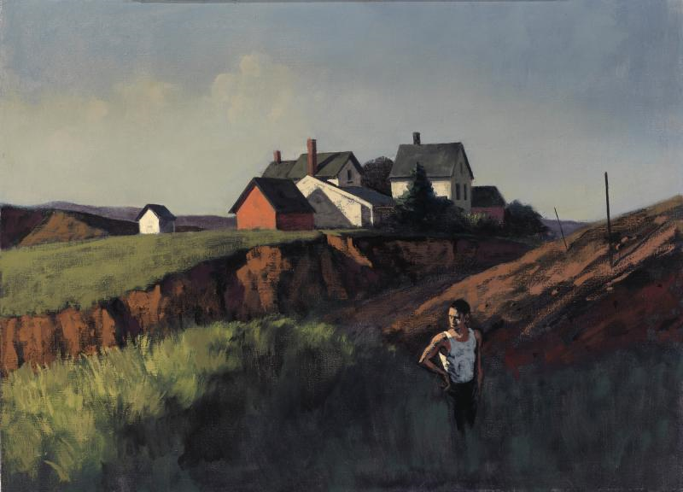
The Stranger
Notes:
This is a 1950s artwork by Hughie Lee-Smith. The artwork explores the themes of exclusion and alienation. The artist believed that African American experience in particular was one of rejection and isolation and feelings of racial disparity frequently influenced this piece of work.

Slide 10
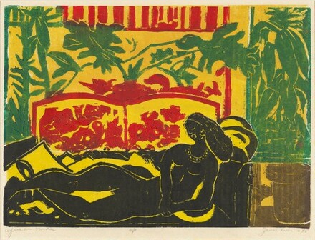
African Nude
Notes:
This is a piece of work by James Lesesne Wells. The piece of art work reflects the struggles of African American women in the American society. The woman in “African Nude”, wearing only a large necklace, reclines on an overstuffed settee. Her alluring position depicts how enslaved women were used as sexual symbols during the 19th century. It tells the social life of many African American women during era of slavery in American history.

Slide 11
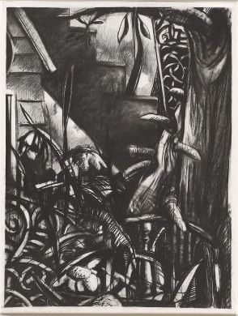
Slum Gardens
Notes:
This is a portrait by Joseph Norman. The densely layered image of Slum Gardens shows a large tree with a thick, spiked vine winding up the trunk. Woods and flowers blanket the bottom half of the image, almost obscuring the wooden shack and the staircase. It defines Norman’s work where he sues landscape imagery to convey meaning. For this piece of work, he drew his experiences growing up in Chicago where he witnessed the effects of poverty on various neighborhoods. Slum Gardens visualizes the concept of “slums” from regions across the world. In this artwork, the overgrowing landscape serves as a metaphor for the lack of attention paid to impoverished neighborhoods. Not only are the physical environments of such areas neglected, but, as Norman suggests, its social and economic problems are ignored as well.

Slide 12
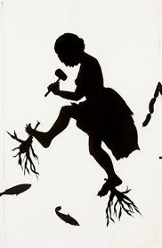
Roots and Links
Notes:
In Kara Walker’s artwork, troubling narratives of violence, lust, and exoticism play out. This work draws upon imagery common in the antebellum South and is controversial for its use of racial stereotypes of blacks. The image focuses on the role of stereotypes in shaping history and their complex function in American race relations today. The abbreviation “Inc.” in the work’s title alludes to the institutionalization of racism and the implicit cultural approval of such degrading images. He portrays how racism is still deep-rooted in society today.

Slide 13
Conclusion
Important African American pieces of art:
Portrait of Mnonja
The Guardian
Blackberry Woman
Soldiers Training
Lamentation
Confrontation
The Stranger
African Nude
Slum Gardens
Roots and Links
All these pieces of art by black artists reflect on social and political themes.
Racism, alienation, black identity, segregation and inequality are some of the themes portrayed by these pieces of art.
Notes:
In conclusion, modern and historical black artists continue to play an important role in portraying some of the important issues that affect society both in history and modern time. They do so through their pieces of art. And in the above exhibition, the artists depict issues that affect the black community in American society. Black people in America have had quite a history with issues to do with racism, segregation, and inequality. And it is through such pieces of art that the community is able to address these issues in order to embrace diversity in society.

Slide 14
Reference
Vendryes, Margaret Rose. Expression and repression of identity: race, religion, and sexuality in the art of American sculptor Richmond Barthe. Diss. Princeton University, 1997.
Patton, Sharon F., and F. Sharon. African-American Art. Vol. 5. Oxford University Press, USA, 1998.
Stokstad, Marilyn, Michael Watt Cothren, and Frederick M. Asher. Art history. HN Abrams, 1999.
Fine, Elsa Honig. "The Afro-American artist: A search for identity." Art Journal 29.1 (1969): 32-35.
Levy, Alan Howard. "The search for identity in American music, 1890-1920." American Music (1984): 70-81.

